Slide 1
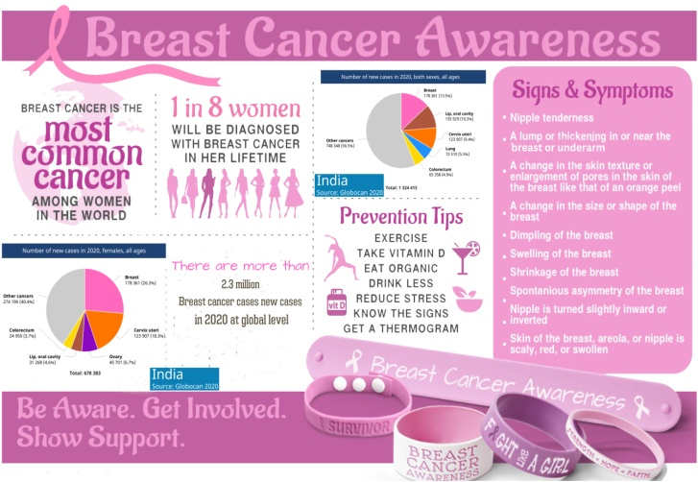
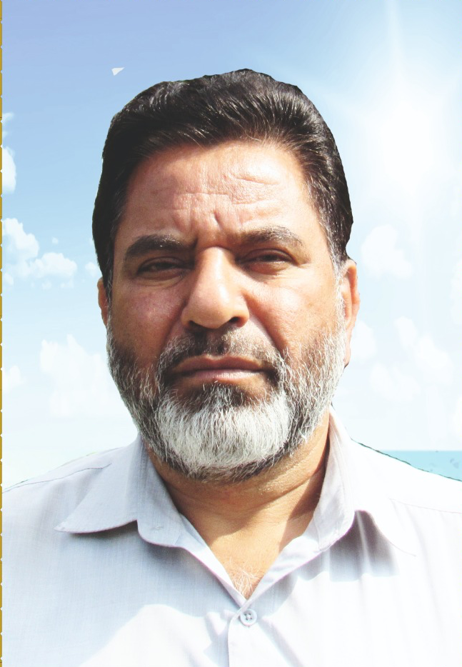
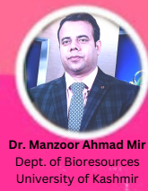
HKM GDC Eidgah Srinagar
and
Department of Bio resources, University of Kashmir
Organizes
One day Breast Cancer Awareness programme
On
19th October 2022
Venue : GDC Eidgah Srinagar
ORGANISES
Highlights of screening cum awareness camp
Health promotion, the first pillar, will include public education about the signs and symptoms of breast cancer, risk reduction strategies.
Lectures on breast cancer by Experts in online and offline mode.
Month long awareness programme is going at University of Kashmir and colleges.
Free breast cancer screening camp will be organized at University of Kashmir on 31-10-2022.
Prof. Mohd Yaqoob Baba
Principal
HKM GDC Eidgah Srinagar
Organizing Secretary : Dr. Nusrat Shafi ( Women Development Cell GDC Eidgah )

